Slide 1
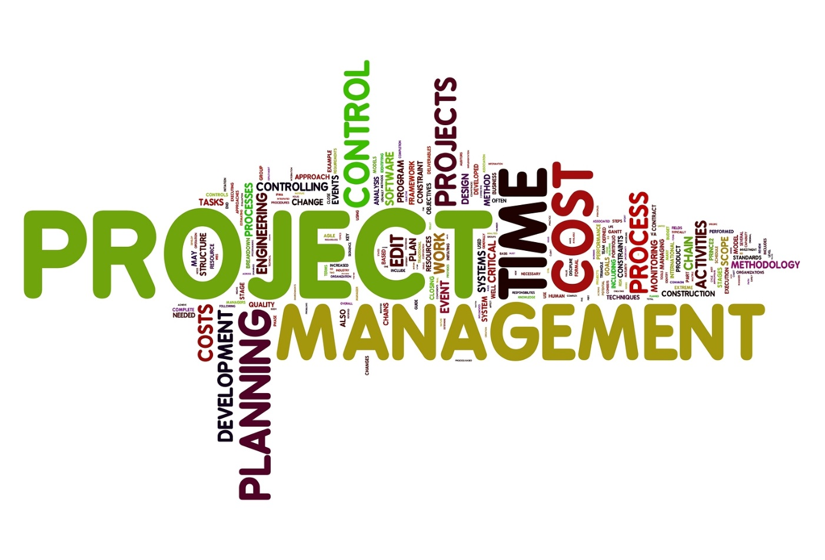
Project Management Techniques for Test Estimation Optimization
Thomas Janik, CSTE, CSQE
DevOps Manager, Release Management
American Family Insurance

Slide 2
Project Management Techniques for Test Estimation Optimization
Session Agenda:
Familiar/Common Test Estimating Techniques
What is a Work Breakdown Structure (WBS)?
What does DONE mean?
Triple Constraint Estimation
Kaizen Events

Slide 3
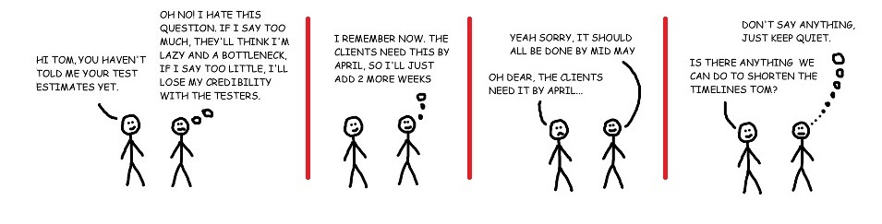
Test Estimation:

Slide 4
Test Estimation: Function / Testing Point Analysis Method
Decide on an effort classification / weight
Divide your application into function points
Classify / weigh each function point
Multiply the weight by the function point for the estimate

Slide 5
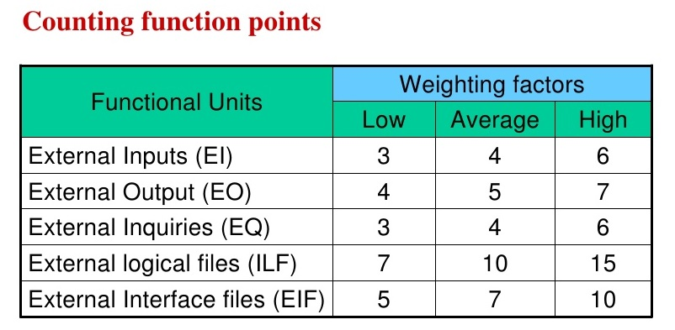
Test Estimation: Function / Testing Point Analysis Method

Slide 6
Test Estimation: Function / Testing Point Analysis Method
Advantages:
Can be generated in early project stages
Can be generated from requirements specifications
… Simple math
Disadvantages:
No variables for unknowns
Accurate only if continually updated
If no requirements exist, estimation must come from ideation

Slide 7
Test Estimation: Use Case Point / Test Case Point Method
Unadjusted actor weights = total number of actors (positive, negative, and exceptional)
Unadjusted use case weight = total number of use cases
Use case point = actor weights + use case weight
Determine EF (Environmental Factor or use .5)
Adjusted use case point = use case point * [0.65+ (0.01 * EF]
Estimate = adjusted use case point * CF (Conversion Factor)
Or … estimate duration/number of executions of each test case

Slide 8
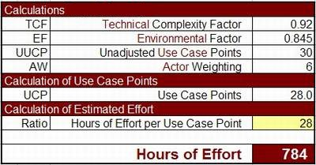
Test Estimation: Use Case Point / Test Case Method

Slide 9
Test Estimation: Use Case Point / Test Case Method
Advantages:
Multiple weighting factors for better accuracy
Experts not needed
Very fast
Disadvantages:
Requires a significant amount of system knowledge
Requires requirements (or test case) completeness first
Coefficients have to be adjusted
… Not so simple math

Slide 10
Test Estimation: Development Percentage Method
Get development estimates
Use a generic % of development for an initial test estimate
Define complexity multiplier
Multiply complexity multiplier by initial test estimate

Slide 11
Test Estimation: Development Percentage Method
Advantages:
Popular / widely used (circa 1996)
Can be incorporated with function points for accuracy
… Simple math
Disadvantages:
Not provable via scientific methods
No different than ad-hoc estimation with a complexity factor

Slide 12
Test Estimation: Experience Best Guess / Ad-hoc Methods
Last time it took 2 months
I think it will be done in 2 weeks
Just test until the release date (or end of sprint)
Everyone knows all testing takes 27% of project time
Don’t estimate … just tell them we’ll be done when we’re done

Slide 13
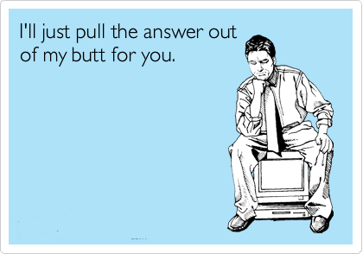
Test Estimation: Experience Best Guess / Ad-hoc Methods

Slide 14
Test Estimation: Experience Best Guess / Ad-hoc Methods
Advantages:
Super easy … just guess (no math!)
Instant estimate
People tend to think it’s accurate because of previous experience
Disadvantages:
Sets project up for missed deadlines
In reality there is minimal accuracy sans ESP

Slide 15
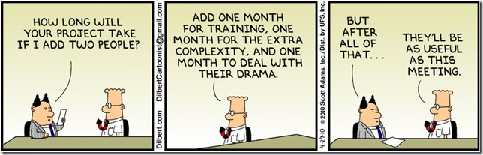
How Can Project Management Techniques Help?

Slide 16
Work Breakdown Structure
Can be the basis for almost all modern test estimation methods
Impossible to estimate anything as a whole
Must understand what DONE looks like (activity later)
Break down functionality into smaller units
Subdivide smaller units (wash, rinse, repeat)
Continue to subdivide until all units are able to be estimated
It’s broken down enough when you can confidently estimate it

Slide 17
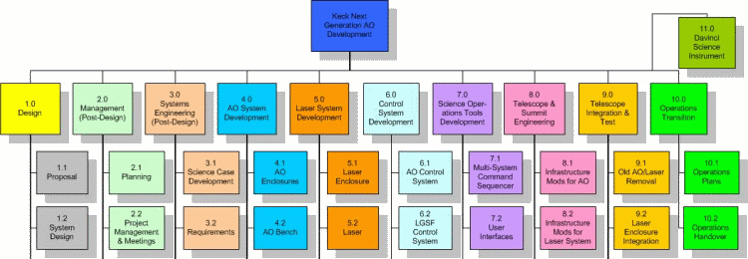

Slide 18
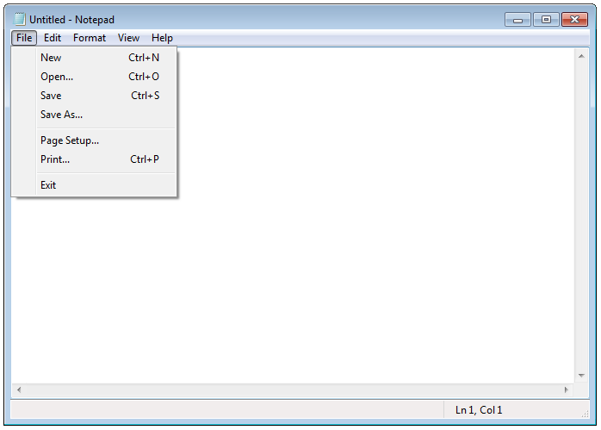

Slide 19
Notepad
Menus
File
Edit
Edit frame
…
Level 1
Level 2
Level 3

Slide 20
Menus
File
New
Open
Edit
Level 2
Level 3
Level 4
Save
Save As
…
Undo
Cut
Copy
Paste
…
Format
Help
View
Word Wrap
Font
Status Bar
View Help
About Notepad

Slide 21
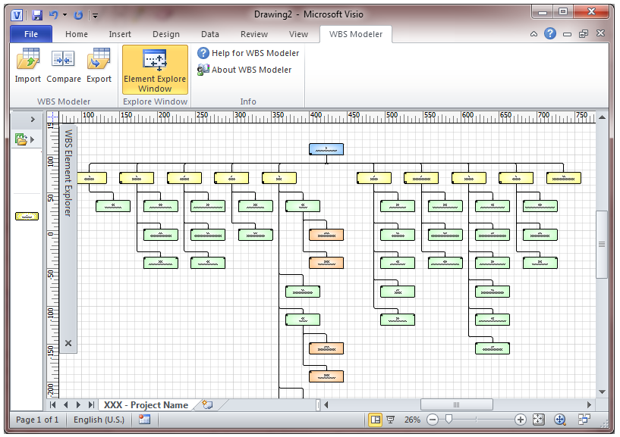

Slide 22
What Does DONE Mean?

Slide 23
Draw a Pig, LLC
Round 1: 1 minute to draw a pig

Slide 24
Draw a Pig, LLC
Round 1: 1 minute to draw a pig
Round 2: 1 minute to draw a pig using the work instructions and grid paper

Slide 25
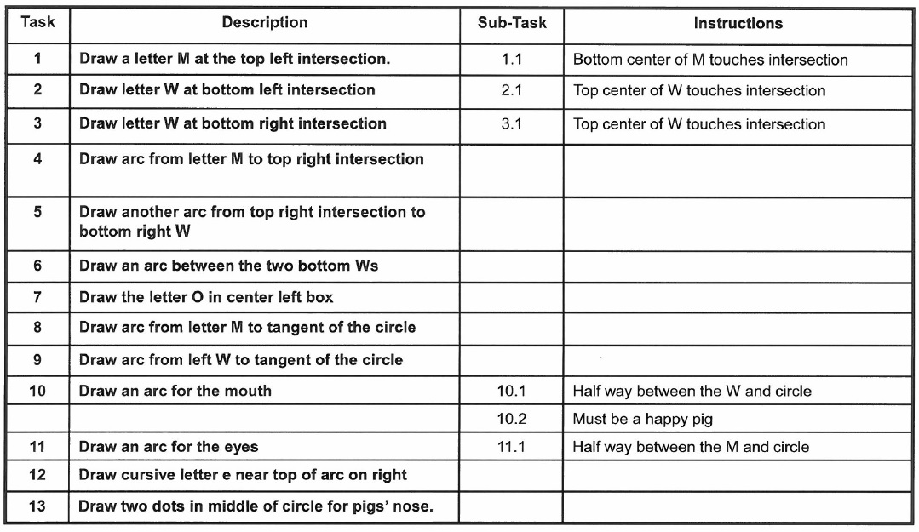

Slide 26
Draw a Pig, LLC
Round 1: 1 minute to draw a pig
Round 2: 1 minute to draw a pig using the work instructions and grid paper
Round 3: 30 seconds to draw a pig using the work instructions, grid paper, and customer image.

Slide 28
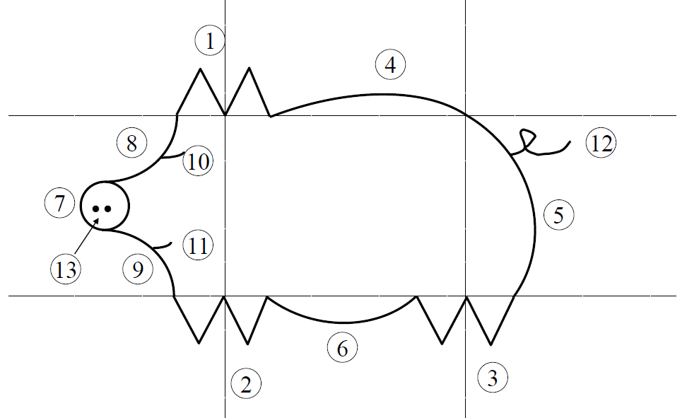

Slide 29
Knowing what DONE means will help your estimates
Interview stakeholders to make sure you understand their definition of DONE and the risks they feel are important
Ask for all available documentation
Requirements
Use Cases
Scope Statements
Wireframes / Comps
Development Timelines (sprint epics, stories, backlog, etc.)
Anything you can get your hands on to help you know / understand what DONE means
When you reach your definition of DONE … actually be done!

Slide 30
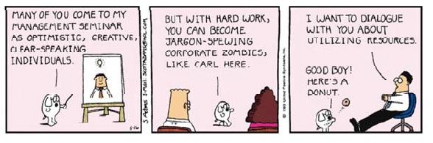
How Can Project Management Techniques Help?

Slide 31
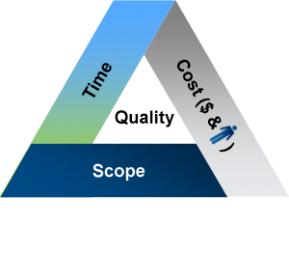
The Triple Constraints Triangle
Cost
Scope
Time

Slide 32
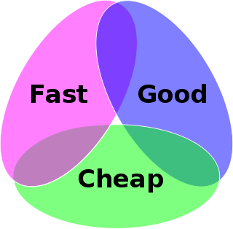
The Triple Constraints Triangle (Euler)
Fast
Good
Cheap

Slide 33
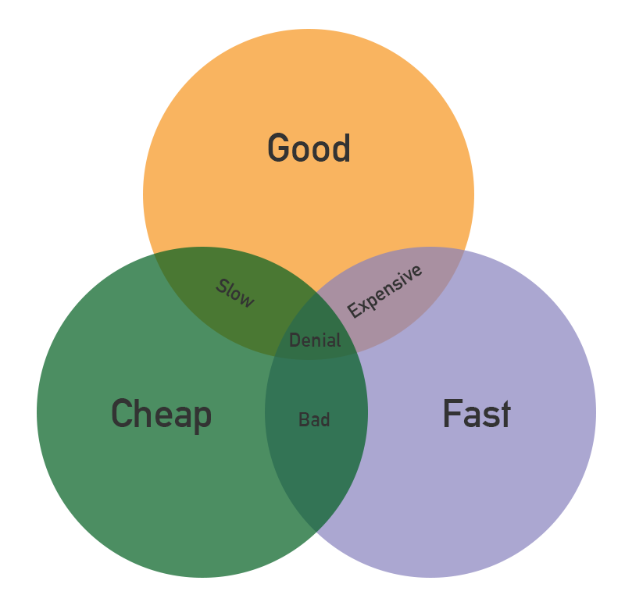
The Triple Constraints Triangle (Euler)
Fast
Good
Cheap

Slide 34
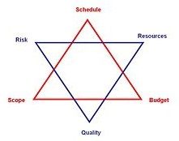
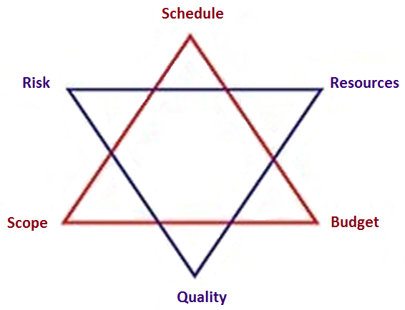
The Triple Constraints “Triangle”
Resources
Budget
Quality
Scope
Risk
Schedule

Slide 35
Using the Triple Constraints Triangle to know what DONE looks like
What are the minimum results to ensure success?
What deadlines and/or business events are important?
Who is impacted if milestones are missed?
What does a quality product mean to you?
Is there functionality that is more important than others?
Does development have functionality prioritized?

Slide 36
Using the Triple Constraints Triangle to optimize your estimates
Use 3 constraints to categorize your test cases, use cases, test scenarios, or units in your WBS
Use the Euler Diagram to determine your two most valuable constraints
Use overlaps in conjunction with any other test method to refine multipliers (environment factors, complexity factor, etc.)
… Simple math

Slide 37
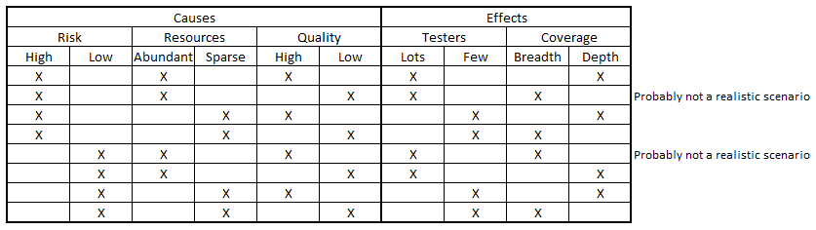
The Triple Constraints Triangle

Slide 38
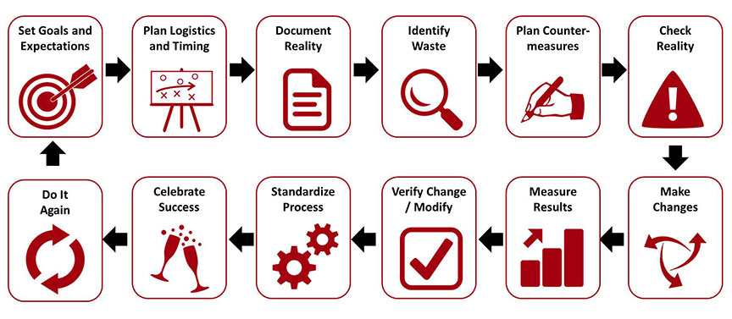
A Kaizen Event
Kaizen Blitz
Kaizen Burst
Focused improvement workshops
Kaizen workshops
Continuous improvement workshops
Accelerated improvement events
Rapid process improvement workshops
Whatever you call them, a Kaizen event has a common aim and structure that looks to harness the ideas and creativity of your workforce in creating a step change improvement in a specific area of your business

Slide 39
A Kaizen Event

Slide 40
Using a Kaizen event to optimize your estimates
Document reality: Use a previous test estimate
Identify waste: Which estimates were way off?
Plan countermeasures: Adjust estimation method
Check reality: Are you still improving reality?
Make changes: Estimate again
Measure results: Compare test estimate to actual
Not a panacea ….

Slide 41
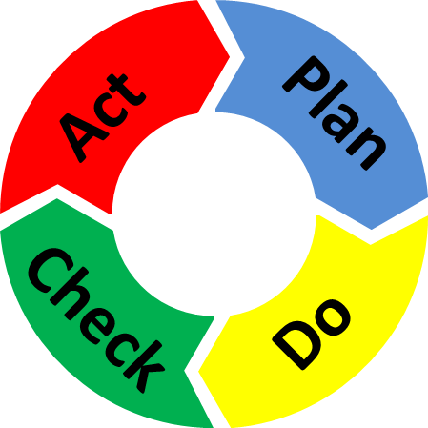
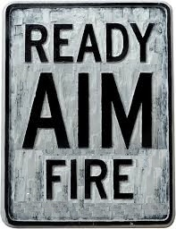
Using a Kaizen event to optimize your estimates

Slide 42
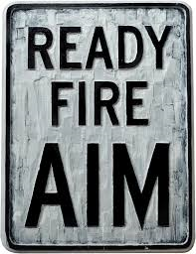
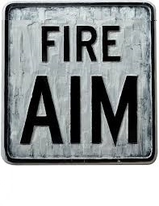
Continuous Improvement

Slide 43
Thank you shout outs ….
https://uwmadison.app.box.com/v/pmfornonpm
Scott Converse, UW Madison
http://www.softwaretestingclass.com/software-estimation-techniques/
http://www.methodsandtools.com/archive/archive.php
http://www.slideshare.net/MasudParvez8/software-outsourcing-and-new-model-of-test-estimation-for-agile-development-47062178
http://leanmanufacturingtools.org/625/planning-and-running-kaizen-events/

Slide 44
Questions?
Project Management Techniques for Test Estimation Optimization
Thomas Janik, CSTE, CSQE
DevOps Manager, Release Management
American Family Insurance

