Slide 1
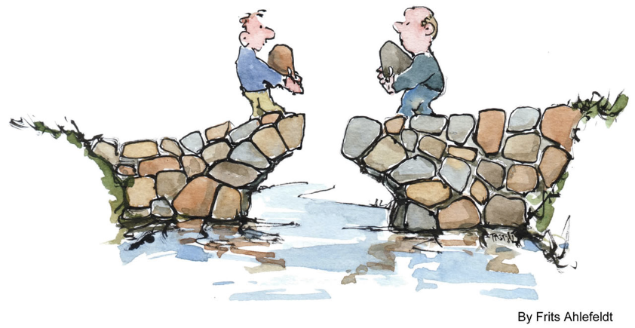
Bridging the Gap Between IT and The Business
Sally Anlin, IT Team Transformations

Slide 2

About Your Presenter
Sally is owner of IT Team Transformations and co-Founder of ethiEffects. Her expertise includes:
Strategic planning, roadmap development, and facilitating adoption of change initiatives
Building and developing high performing teams
Training, coaching, and mentoring executives, managers, and professionals
Assessing maturity level; designing and creating best practice Centers of Excellence
Teaching, coaching skills development on Project Management and Business Analysis Best Practices
Notes:
Note upcoming Analyzing and Validating class.
Once thing I’ve noted as my career has evolved is the hybrid role

Slide 3
Evolving IT
IT Organizations are complex and varied.
One thing that is essential for
all IT organizations
is to be a
value-added business partner.
Unique and Varied
Copyright 2015 ANLIN Consulting, LLC

Slide 4
To Build A Bridge
First Know Who You Are and Where You Are Going

Slide 5
Four Components of IT Organization
The Business
Future State Vision
Delivery Methodology
Structure
Departmental Persona
Additional factors: size, history, geography, …
Notes:
Then will mention a couple of above BA roles for each area – refer to non-IT.

Slide 6
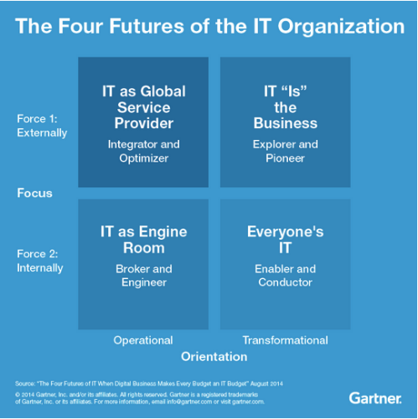
Future State
The Business
Future State Vision
Delivery Methodology
Structure
Departmental Persona

Slide 7
Operations + Strategy = Value Added Business Partner
Business Partnership
Business Understanding
Operational Support
Tactical
Technical Expertise
Process Optimization
Strategy
Forward Thinking

Slide 8

Future State
The Business
Future State Vision
Delivery Methodology
Structure
Departmental Persona
Each Quadrant Brings Value When
Worked Together

Slide 9
Methodology
The Business
Future State Vision
Delivery Methodology
Structure
Departmental Persona
KANBAN
CMMI
Waterfall
LEAN
PMI
XP
Kaisen
Ad Hoc
Agile
RUP
ITL
Six Sigma
Scrum
ISO
PHASE/GATE

Slide 10
Methodology
Divides
Picked to meet IT’s desires/needs/wants
Reliance on business’ understanding of methodology
Bridges
UX review components of methodology from Business perspective
Listen for and capitalize on learning moments

Slide 11
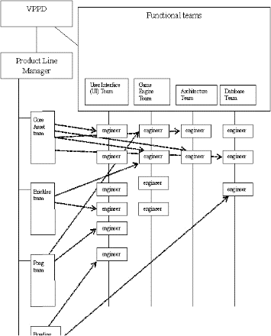
Structure
The Business
Future State Vision
Delivery Methodology
Structure
Departmental Persona
Functional
Process
Product
Market
Projectized
Matrix
Strong
Balanced
Weak
Outsourced

Slide 12
Departmental Persona
The Business
Future State Vision
Delivery Methodology
Structure
Departmental Persona
The Consultant
The Controller
The Consolidator
The Caretaker
The Creator

Slide 13
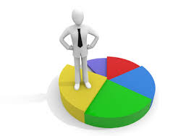
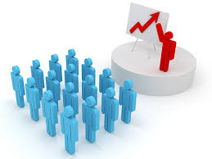
The Consultant

Slide 14
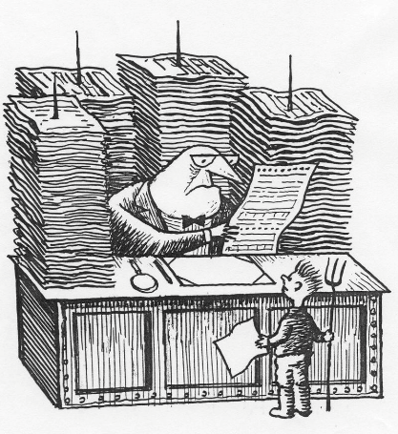

The Controller

Slide 15


The Consolidator

Slide 16


The Caretaker

Slide 17

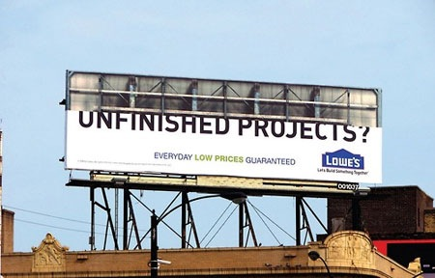
The creator

Slide 18
Building the Bridge
Analyze & Plan
Decision Making
Managing Change
L I S T E N I N G

Slide 19
Analyzing
IT’s Core Strength
Use IT
for Good

Slide 20
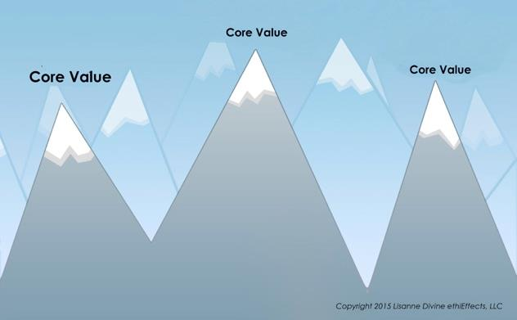
Analyzing Peaks and Valleys

Slide 21
Planning
Must be stated goal with tangible outcomes
Beyond a traditional Project Plan
Systems and actions over goals and plans

Slide 22
Beyond a traditional Project Plan
Setting and communicating the intention
Goals and Outcomes
Creating a System
Actions
Leadership
Individuals
Building partners

Slide 23
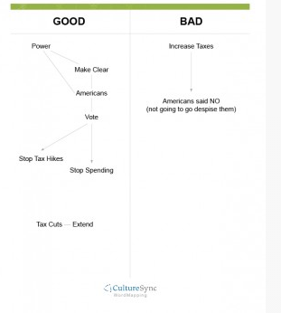
Word Mapping: Build Rapport and Understand What is Important
Notes:
Need to have:
-Sticky Notes
-Long table or Wall – Draw stages to have them put sticky on
No such thing as a ‘bad’ word. The key to moving forward and elevating culture is acknowledging all aspects

Slide 24
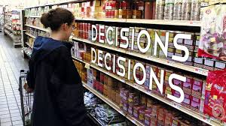
Decision Making
Decision Fatigue
Choice Paralysis

Slide 25
Listening
Find Out What’s Important:
Capacity to Speak, Hear, and Read
Learn Active Listening Techniques
Click Down
Playing a Movie
Word Mapping

Slide 26
Click Down
Identify by ‘clicking down’ into areas of interest and importance:
Start with asking a general who, what, or where question
Listen for and notice ‘blue, underlined’ words
Ask an open ended question about the key word(s)
Repeat until you reach a core ‘real’ issue, desire, or value
Active listening naturally through conversation
Notes:
Listening technique to help focus active listening…
-Helps stop and suspend judgment and focusing on keying in on words that the other person is using focusing on what is important to them without interjecting your own biases for what is important

Slide 27
Click Down
What is it about … that …?
When you mentioned X, where …?
How do you… ?
Some ways to continue
Avoid Why

Slide 28

To Practice
Ask to describe a situation in which IT and The Business worked well together (or didn’t).
Mentor ask the mentee to describe with open ended questions
Mentor listen to determine root cause
3 Rounds: Each mentor, mentee, and observer taking notes
Notes:
12 minutes total

Slide 29
Make a Movie
Use your mental capacity to focus and hear beyond words.
As the other person is talking create a movie scene within your mind. Create all the details. Set, lighting, dress, characters, etc.
To Focus Listening and Hear What Others Really Say

Slide 30

Change
Bridges are built one stone at a time
Notes:
90 Day Myth – The Rest of the Story

Slide 31

Stay Connected
Sally Anlin
414-322-5071
Sally@ITTeamTransformations.com

